Slide 1
Task 4
Team members
name | sec | bn
Mohammed Ahmed Hassan Ahmed | 2 | 37
Ibrahim Thabet Allam | 1 | 1
Mohammed Hatem Mohammed Saeed | 2 | 39
Mohamed Hassan Gad Ali | 2 | 41
Mohammed Abd El Mawgoud Ghoneam | 2 | 43

Slide 2
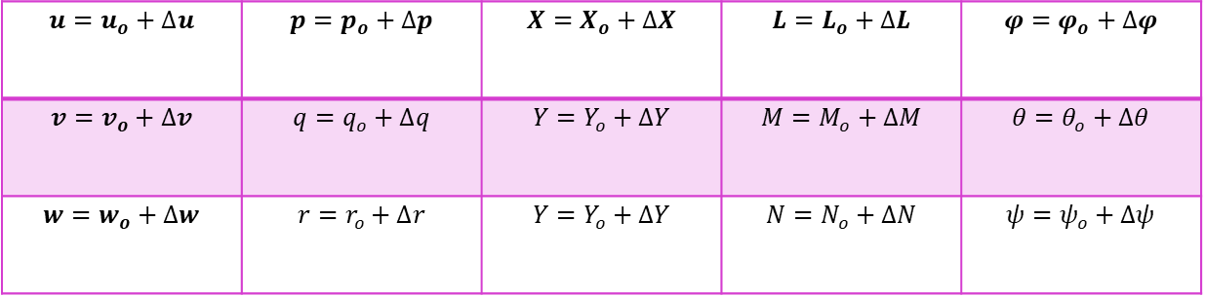
Linearization
By using small perturbation theory we can linearize EOM’s of the airplane
$$u=u_{o}+∆u$$ | $$p=p_{o}+∆p$$ | $$X=X_{o}+∆X$$ | $$L=L_{o}+∆L$$ | $$φ=φ_{o}+∆φ$$
$$v=v_{o}+∆v$$ | $$q=q_{o}+∆q$$ | $$Y=Y_{o}+∆Y$$ | $$M=M_{o}+∆M$$ | $$θ=θ_{o}+∆θ$$
$$w=w_{o}+∆w$$ | $$r=r_{o}+∆r$$ | $$Y=Y_{o}+∆Y$$ | $$N=N_{o}+∆N$$ | $$ψ=ψ_{o}+∆ψ$$

Slide 3
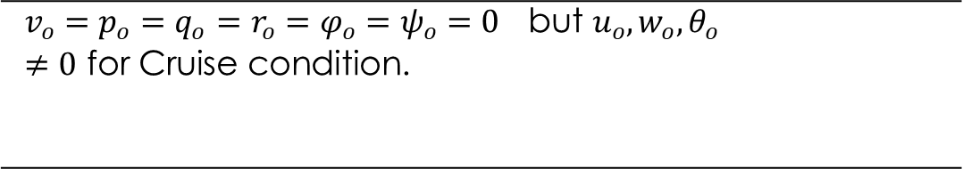
Reference Flight condition
$$v_{o}=p_{o}=q_{o}=r_{o}=φ_{o}=ψ_{o}=0 \text{but} u_{o},w_{o},θ_{o}≠0 \text{for} \text{Cruise} \text{condition}\text{.}$$

Slide 4
Linearization Technique
Step 1
step4
step3
Recast each variable in terms of a steady-state value and a perturbed value.
step2
Apply the small-angle assumption to trig functions of perturbed angle
Assume products of small perturbations are negligible.
Remove the steady-state equation from the perturbed equation.

Slide 5
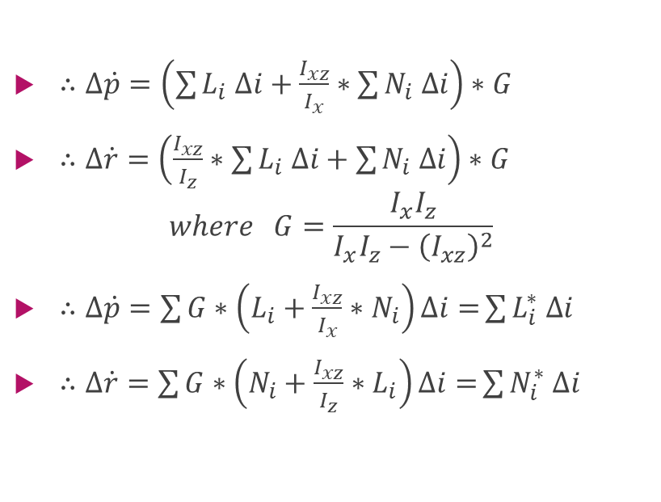
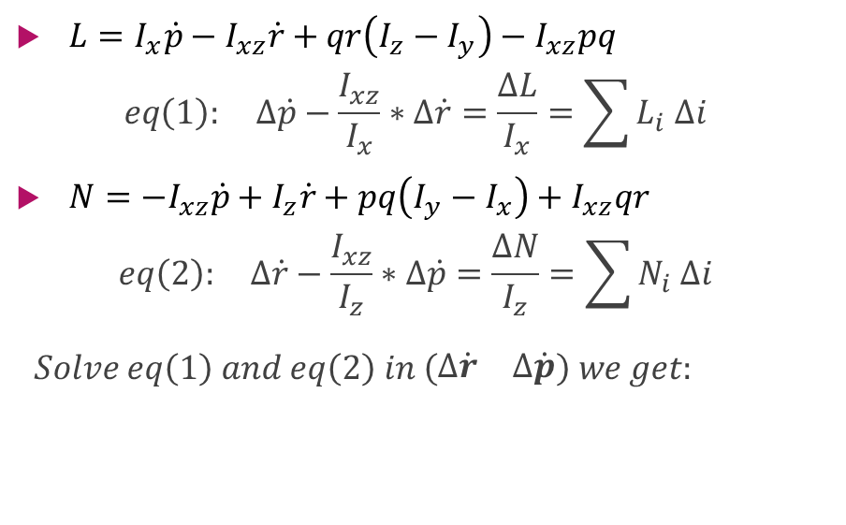
Notes in Lateral calculations
$L=I_{x}\dot{p}−I_{xz}\dot{r}+qr\left(I_{z}−I_{y}\right)−I_{xz}pq$
$$eq\left(1\right): ∆\dot{p}−\frac{I_{xz}}{I_{x}}∗∆\dot{r}=\frac{∆L}{I_{x}}=\sum{L_{i} ∆i}$$
$N={−I}_{xz}\dot{p}+I_{z}\dot{r}+pq\left(I_{y}−I_{x}\right)+I_{xz}qr$
$$eq\left(2\right): ∆\dot{r}−\frac{I_{xz}}{I_{z}}∗∆\dot{p}=\frac{∆N}{I_{z}}=\sum{N_{i} ∆i}$$
$$Solve eq\left(1\right) and eq\left(2\right) in \left(\begin{matrix}∆\dot{r} & ∆\dot{p}\end{matrix}\right) we get:$$
$∴∆\dot{p}=\left(\sum{L_{i} ∆i}+\frac{I_{xz}}{I_{x}}∗\sum{N_{i} ∆i}\right)∗G$
$∴∆\dot{r}=\left(\frac{I_{xz}}{I_{z}}∗\sum{L_{i} ∆i}+\sum{N_{i} ∆i}\right)∗G$
$$where G=\frac{I_{x}I_{z}}{I_{x}I_{z}−{\left(I_{xz}\right)}^{2}}$$
$∴∆\dot{p}=\sum{G∗\left(L_{i}+\frac{I_{xz}}{I_{x}}∗N_{i}\right)∆i=}\sum{L_{i}^{∗} ∆i}$
$∴∆\dot{r}=\sum{G∗\left(N_{i}+\frac{I_{xz}}{I_{z}}∗L_{i}\right)∆i=}\sum{N_{i}^{∗} ∆i}$

Slide 6
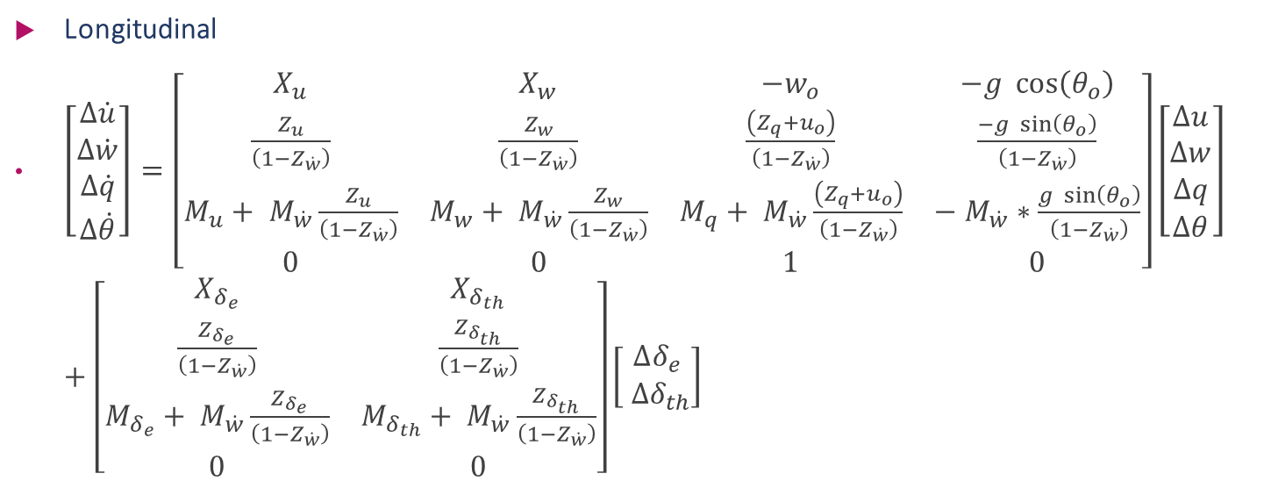
State space Model:
Longitudinal
$\left[\begin{aligned}Δ\dot{u} \\ Δ\dot{w} \\ Δ\dot{q} \\ Δ\dot{θ}\end{aligned}\right]=\left[\begin{matrix}X_{u} & X_{w} & −w_{o} & −g \cos\left(θ_{o}\right) \\ \frac{Z_{u}}{\left(1−Z_{\dot{w}}\right)} & \frac{Z_{w}}{\left(1−Z_{\dot{w}}\right)} & \frac{\left(Z_{q}+u_{o}\right)}{\left(1−Z_{\dot{w}}\right)} & \frac{−g \sin\left(θ_{o}\right)}{\left(1−Z_{\dot{w}}\right)} \\ M_{u}+ M_{\dot{w}}\frac{Z_{u}}{\left(1−Z_{\dot{w}}\right)} & M_{w}+ M_{\dot{w}}\frac{Z_{w}}{\left(1−Z_{\dot{w}}\right)} & M_{q}+ M_{\dot{w}}\frac{\left(Z_{q}+u_{o}\right)}{\left(1−Z_{\dot{w}}\right)} & − M_{\dot{w}}∗\frac{g \sin\left(θ_{o}\right)}{\left(1−Z_{\dot{w}}\right)} \\ 0 & 0 & 1 & 0\end{matrix}\right]\left[\begin{aligned}Δu \\ Δw \\ Δq \\ Δθ\end{aligned}\right]+\left[\begin{matrix}X_{δ_{e}} & X_{δ_{th}} \\ \frac{Z_{δ_{e}}}{\left(1−Z_{\dot{w}}\right)} & \frac{Z_{δ_{th}}}{\left(1−Z_{\dot{w}}\right)} \\ M_{δ_{e}}+ M_{\dot{w}}\frac{Z_{δ_{e}}}{\left(1−Z_{\dot{w}}\right)} & M_{δ_{th}}+ M_{\dot{w}}\frac{Z_{δ_{th}}}{\left(1−Z_{\dot{w}}\right)} \\ 0 & 0\end{matrix}\right]\left[\begin{aligned}∆δ_{e} \\ ∆δ_{th}\end{aligned}\right]$

Slide 7
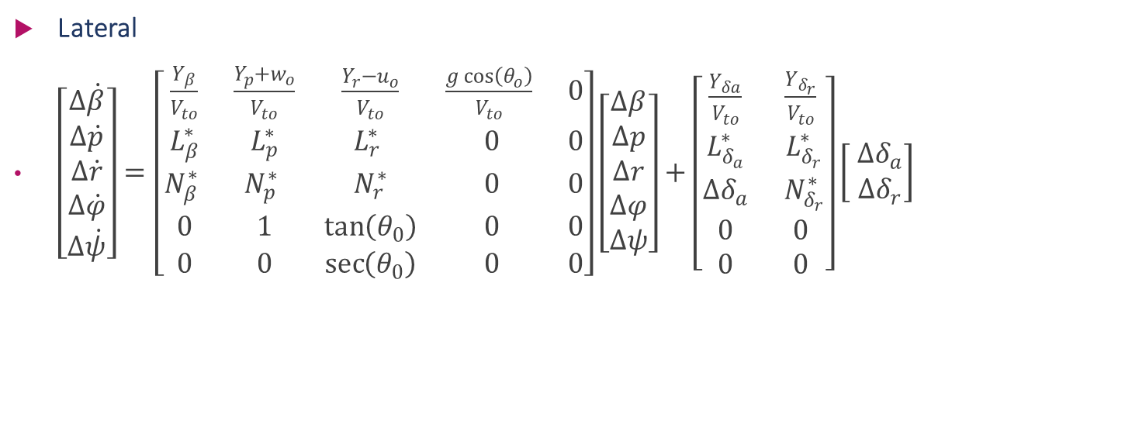
State space Model:
Lateral
$\left[\begin{aligned}Δ\dot{β} \\ Δ\dot{p} \\ Δ\dot{r} \\ Δ\dot{φ} \\ Δ\dot{ψ}\end{aligned}\right]=\left[\begin{matrix}\frac{Y_{β}}{V_{to}} & \frac{Y_{p}+w_{o}}{V_{to}} & \frac{Y_{r}−u_{o}}{V_{to}} & \frac{g\cos\left(θ_{o}\right)}{V_{to}} & 0 \\ L_{β}^{∗} & L_{p}^{∗} & L_{r}^{∗} & 0 & 0 \\ N_{β}^{∗} & N_{p}^{∗} & N_{r}^{∗} & 0 & 0 \\ 0 & 1 & \tan\left(θ_{0}\right) & 0 & 0 \\ 0 & 0 & \sec\left(θ_{0}\right) & 0 & 0\end{matrix}\right]\left[\begin{aligned}Δβ \\ Δp \\ Δr \\ Δφ \\ Δψ\end{aligned}\right]+\left[\begin{matrix}\frac{Y_{δa}}{V_{to}} & \frac{Y_{δ_{r}}}{V_{to}} \\ L_{δ_{a}}^{∗} & L_{δ_{r}}^{∗} \\ ∆δ_{a} & N_{δ_{r}}^{∗} \\ 0 & 0 \\ 0 & 0\end{matrix}\right]\left[\begin{aligned} ∆δ_{a} \\ ∆δ_{r}\end{aligned}\right]$

Slide 8
short period & Long period approximations of the Longitudinal dynamics
By solving the A matrix we get 2 pairs of conjugate roots the pair which has small real part has big settling time according to $T_{s}=\frac{4}{ζω_{n}}$ on the other hand with the pair which has bigger real part
By solving the A matrix we get 2 pairs of conjugate roots the pair which has small real part has big settling time according to 𝑇_𝑠=4/(𝜁𝜔_𝑛 ) on the other hand with the pair which has bigger real part

Slide 9
short period & Long period

Slide 10
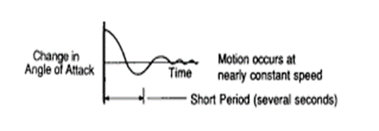
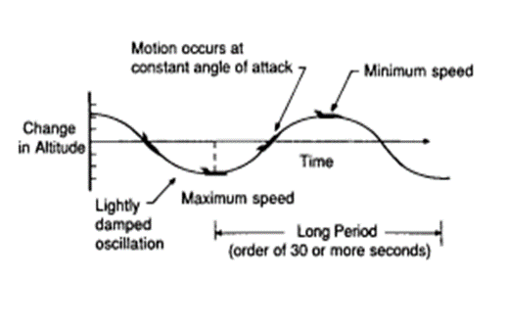
short period & Long period approximations of the Longitudinal dynamics
Short Period
Long period

Slide 11
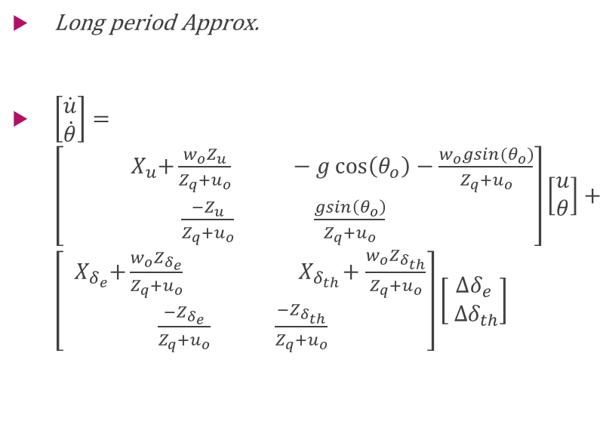
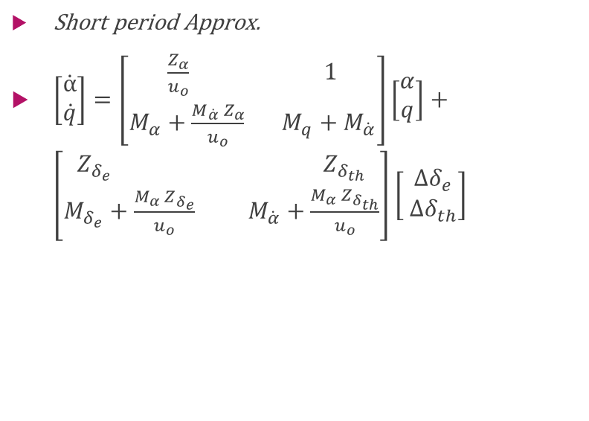
short period & Long period approximations of the Longitudinal dynamics
Short period Approx.
$\left[\begin{aligned}\dot{α} \\ \dot{q}\end{aligned}\right]=\left[\begin{aligned}\frac{Z_{α}}{u_{o}} 1 \\ M_{α}+\frac{{M_{\dot{α}} Z}_{α}}{u_{o}} M_{q}+M_{\dot{α}}\end{aligned}\right]\left[\begin{aligned}α \\ q\end{aligned}\right]+\left[\begin{aligned}Z_{δ_{e}} Z_{δ_{th}} \\ M_{δ_{e}}+\frac{{M_{α} Z}_{δ_{e}}}{u_{o}} M_{\dot{α}}+\frac{{M_{α} Z}_{δ_{th}}}{u_{o}}\end{aligned}\right]\left[\begin{aligned} ∆δ_{e} \\ ∆δ_{th}\end{aligned}\right]$
Long period Approx.
$\left[\begin{aligned}\dot{u} \\ \dot{θ}\end{aligned}\right]=\left[\begin{aligned}\begin{aligned}{ X}_{u}+\frac{w_{o}Z_{u}}{Z_{q}+u_{o}} −g\cos\left(θ_{o}\right)−\frac{w_{o}gsin(θ_{o})}{Z_{q}+u_{o}}\end{aligned} \\ \frac{−Z_{u}}{Z_{q}+u_{o}} \frac{gsin\left(θ_{o}\right)}{Z_{q}+u_{o}} \end{aligned}\right]\left[\begin{aligned}u \\ θ\end{aligned}\right]+\left[\begin{aligned}{ X}_{δ_{e}}+\frac{w_{o}Z_{δ_{e}}}{Z_{q}+u_{o}} { X}_{δ_{th}}+\frac{w_{o}Z_{δ_{th}}}{Z_{q}+u_{o}} \\ \frac{−Z_{δ_{e}}}{Z_{q}+u_{o}} \frac{−Z_{δ_{th}}}{Z_{q}+u_{o}} \end{aligned}\right]\left[\begin{aligned}∆δ_{e} \\ ∆δ_{th}\end{aligned}\right]$

Slide 12
Results due to elevator input 5 degree

Slide 13
Results due to elevator input

Slide 14
Results due to Thrust input 10000

Slide 15
Results due to Thrust input 10000

